Slide 1
Chapter 11 Image Analysis and Recognition

Slide 2
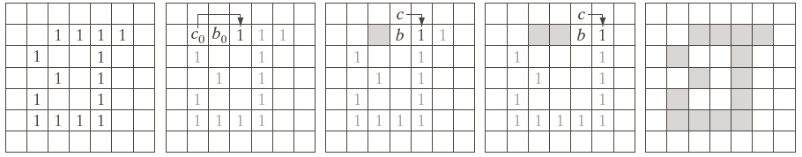
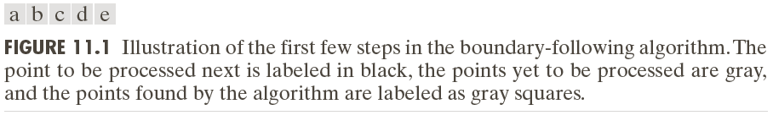
Chain Code
Boundary following algorithm

Slide 3
Chain Code
Boundary following algorithm
Input: f(x,y),binary image
Output: {(xi,yi)},closed digital path

Slide 4
Chain Code
Boundary following algorithm
 |  | p6 | p7 | p8 | p9
 | p5 |  |  |  | p10
 | p4 |  |  |  | p11
 | p3 |  |  |  | p12
 | p2 |  |  | p13
 |  | p1 | p0

Slide 5
Chain Code
Boundary following algorithm
 |  | p6 | p7 | p8 | p9
 | p5 |  |  |  | p10
 | p4 |  |  |  | p11
 | p3 |  |  |  | p12
 | p2 |  |  | p13
 |  | p1 | p0

Slide 6
Chain Code

Slide 7
Chain Code

Slide 8
Chain Code
Direction of Digital Path (Curve)
Pi:(xi,yi)
K steps Forward Direction
K steps Inverse Direction

Slide 9
Chain Code
Curvature of digital path (curve)
K step curvature

Slide 10
Chain Code
Corner Detection
The Corner is the point of maximum curvature in a curve.

Slide 11
Chain Code
Application of chain code
Shape description

Slide 12
Skeleton
Thinning Algorithm (Demo)

Slide 13
Skeleton
Fingerprint Recognition

Slide 14
Hough Transform
Horizontal & Vertical Line Detection
Horizontal integral projecting
Vertical integral projection

Slide 15
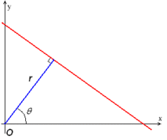

Hough Transform
Function of line (Slope - intercept)

Slide 16
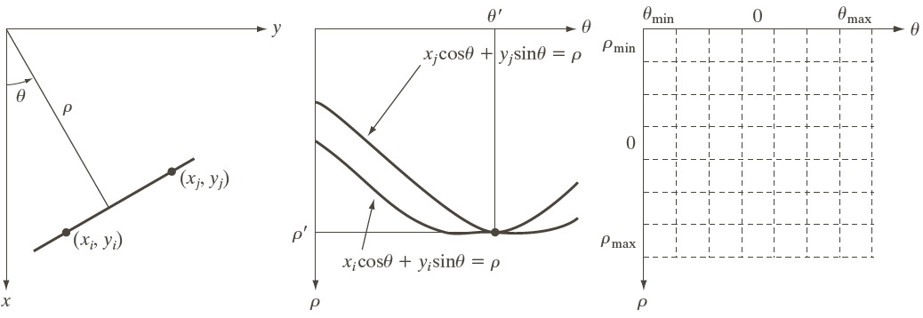
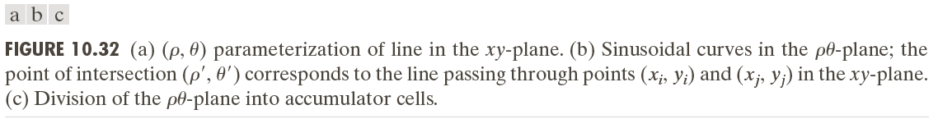
Hough Transform

Slide 17
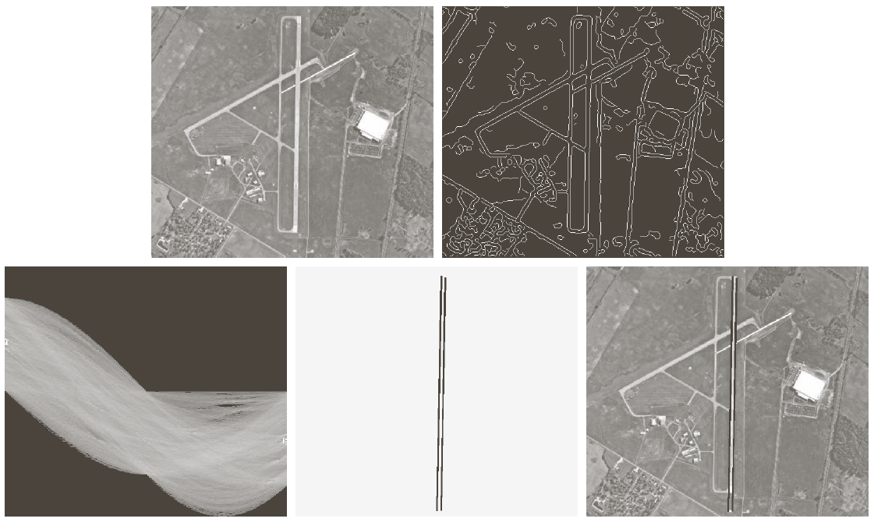
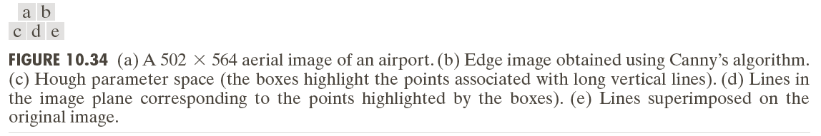
Hough Transform

Slide 18
Hough Transform
specify subdivisions in the parameter space (Parameter space =>accumulator space)
For each edge pixel (xi,yi), [Vote operation]
The position in accumulator space of local maxima point is the parameter of line in the input image.

Slide 19
Hough Transform
Circle detection
Ellipse detection
How to accelerate Hough transform
Using the gradient direction to reduce the number of votes

Slide 20
Moment Invariants
2D moment of order (p+q) of a digital image f(x,y) of size MXN:

Slide 21
Moment Invariants
2D central moment of order (p+q) of a digital image f(x,y) of size MXN:

Slide 22
Moment Invariants
If f(x,y) is a binary image,……

Slide 23
Moment Invariants
Normalized central moment

Slide 24
Moment Invariants
Set of seven invariant moments

Slide 25
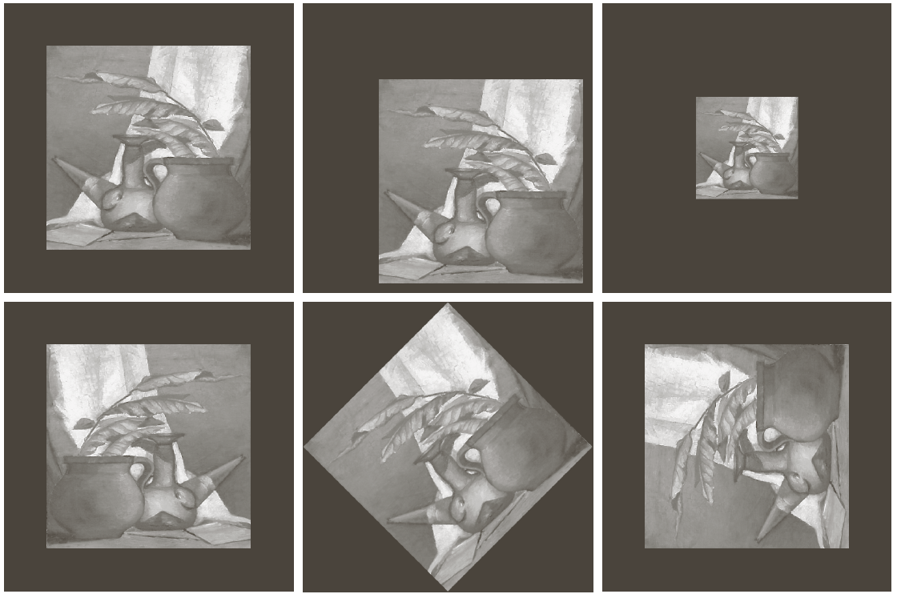
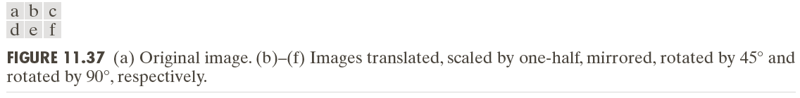
Moment Invariants

Slide 26
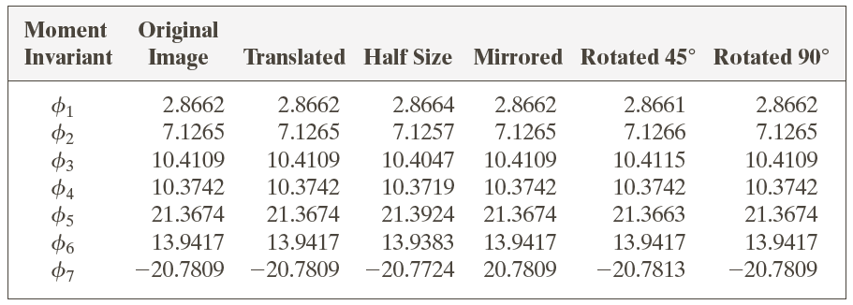
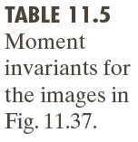
Moment Invariants

